Slide 1
Optical Character Recognition
Name of Mentor
Ms. Rubeena Vohra
(Asst. Prof.)
Gagan Deep Singh
Mohit Manchanda
Sakshi Shreya
Shivangi Rohilla

Slide 2
CONTENTS
What is OCR?
Objectives
Methodology
What are Artificial Neural Networks?
Conclusion
References

Slide 3
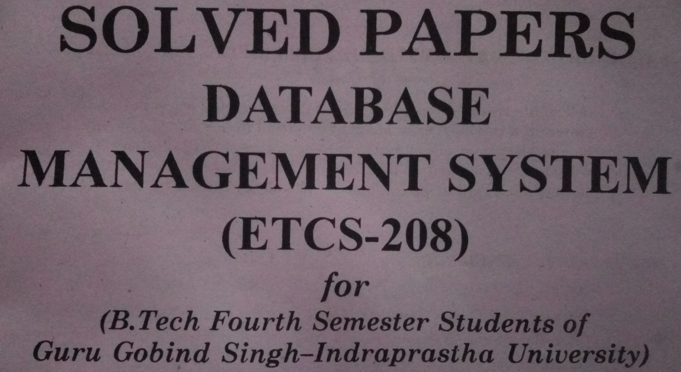
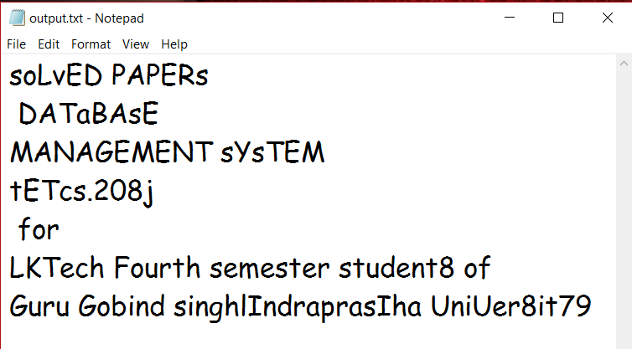
Optical Character Recognition
Picture with text → Editable text
Process of extracting text from images.
Common method of digitizing printed texts.

Slide 4
Objectives
To create an OCR program that inputs an image, extract lines, words and characters from the image.
To recognize the characters extracted by using trained Artificial Neural Network and write those characters in a text file.

Slide 5
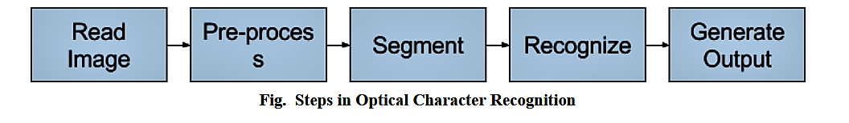
Methodology

Slide 6
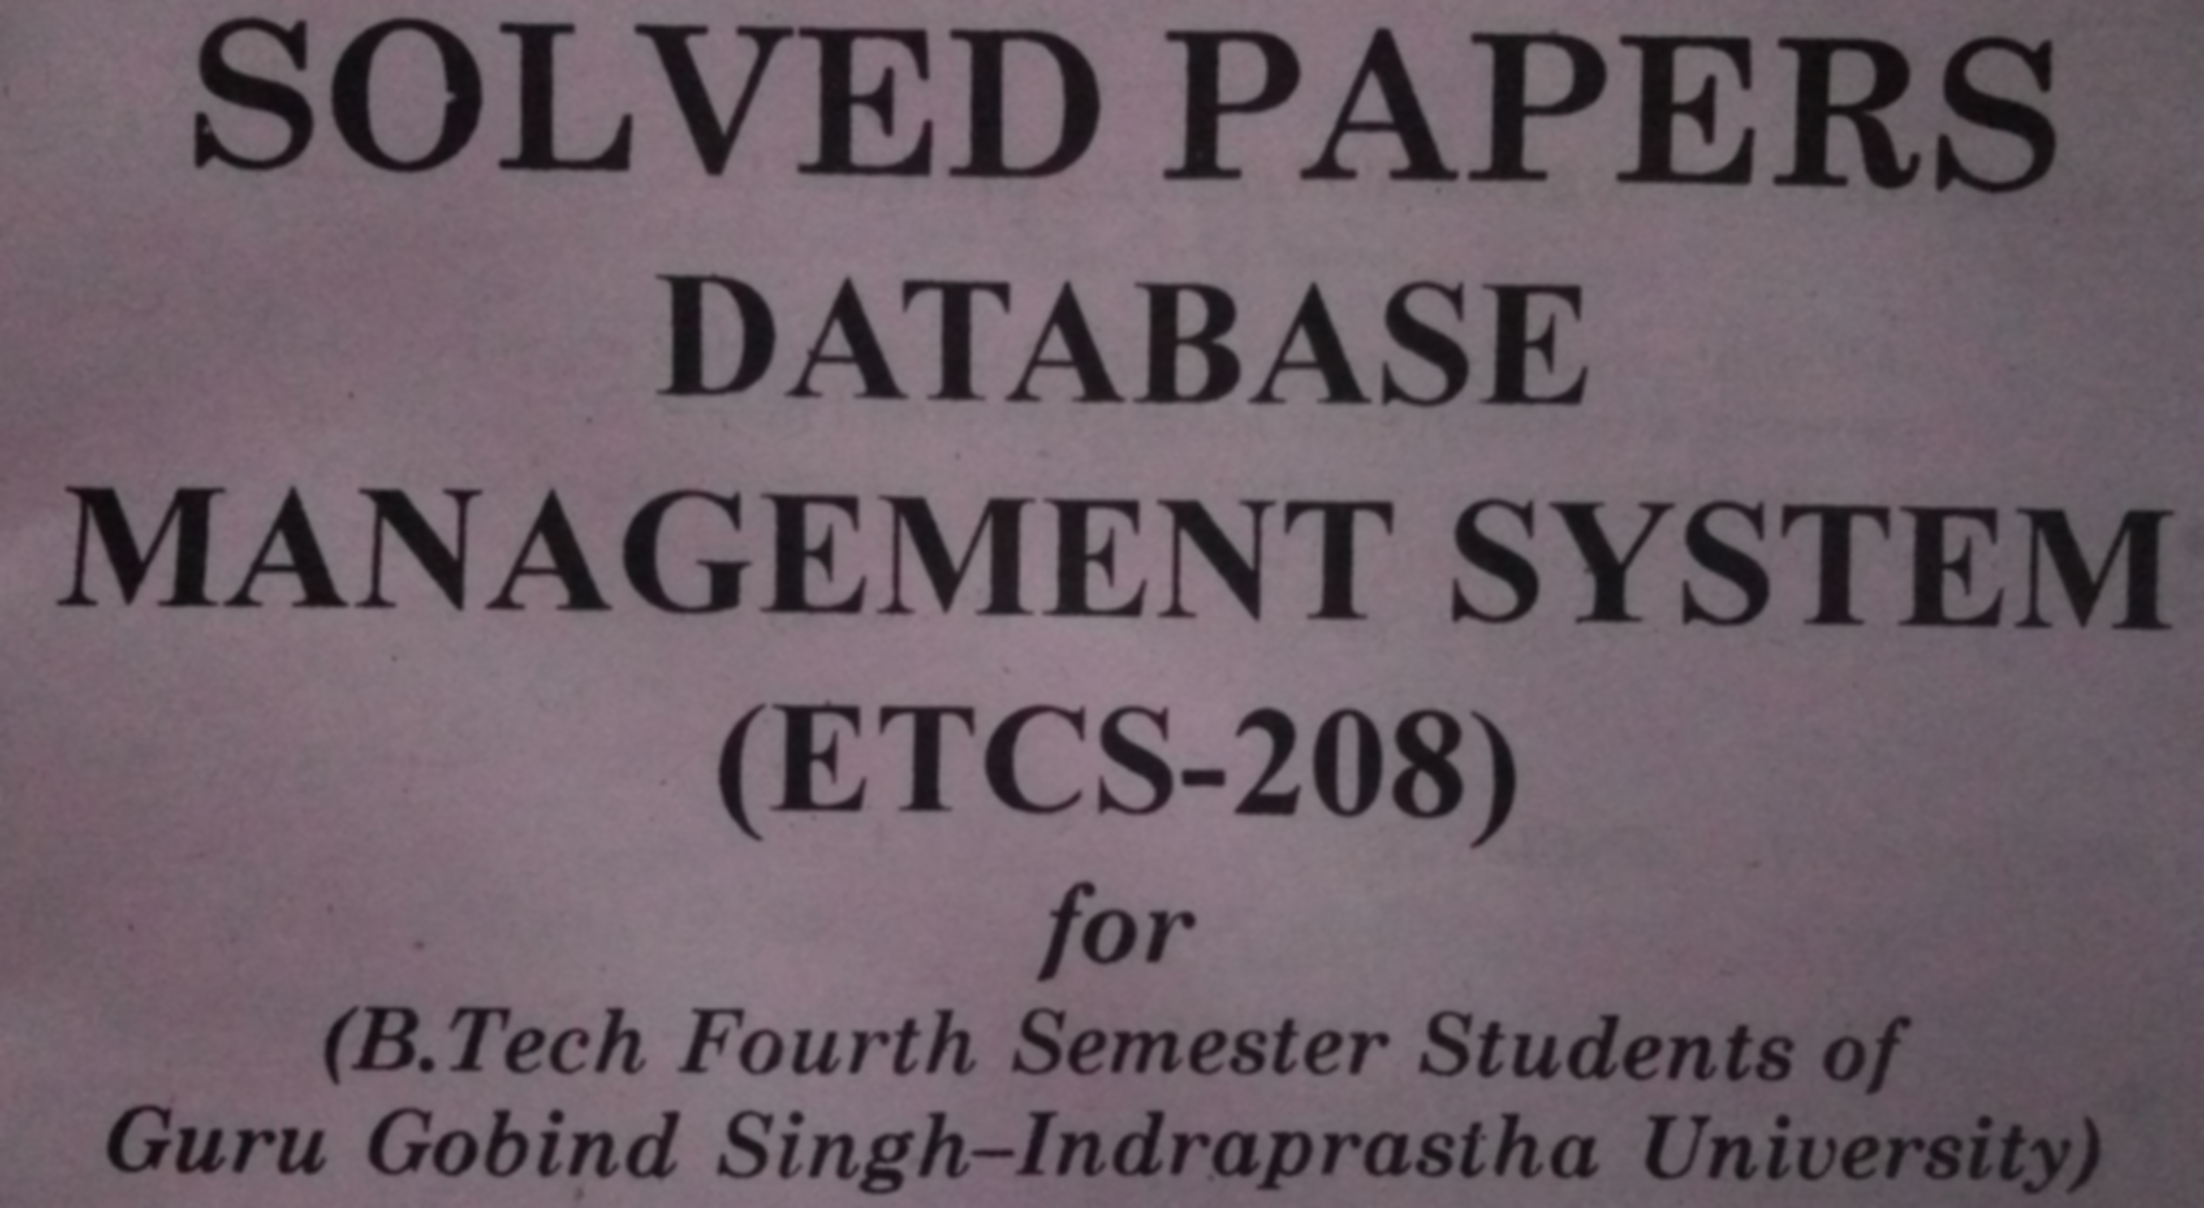
Pre-processing- Noise Removal
Fig. Original Image
Fig. Image after Noise Removal
Removing noise using Gaussian Blur

Slide 7
How Blurring/smoothing is done?
Smoothing is done by sliding a kernel (filter) across the image.
Each pixel value will be calculated based on the value of the kernel and the overlapping pixel's value of the original image.
Gaussian filter takes the neighborhood around the pixel and find its Gaussian weighted average.
Highly effective in noise removal and is fast.

Slide 8
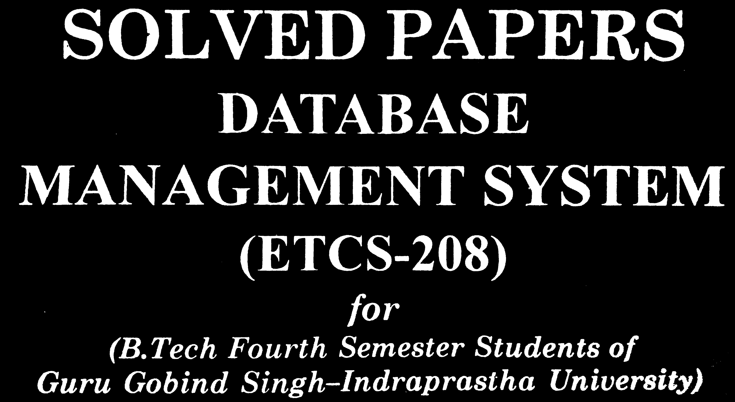
Pre-processing- Thresholding
Fig. Image after Noise Removal
Fig. Image after Thresholding

Slide 9
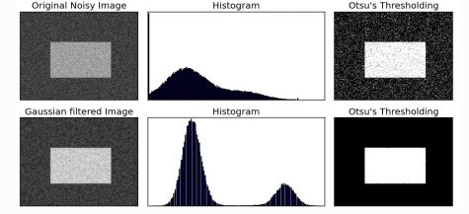
How Thresholding is done?
If pixel value is greater than a threshold value, it is assigned one value(may be white), else it is assigned another value(may be black).
The image is then inverted so that we can get an image which has white text and black background.

Slide 10


Pre-processing- Rotation
Fig. Tilt Detection
Fig. Image after Tilt Correction
Rotating the image to get correct orientation

Slide 11
How Rotation is done?
Finding the smallest rectangle enclosing all pixels having value 255 (white)
Finding inclination of the rectangle with the horizontal
Applying corresponding tilt to get corrected image

Slide 12

Segmentation – Line Segmentation
Fig. Image Before Line Segmentation
Fig. Image After Line Segmentation
Consists of slicing a page of text into its different lines.

Slide 13
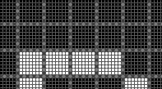
How Line Segmentation is done?
Take horizontal projection of each row of pixels.
Find consecutive empty rows of pixels
Finding threshold
Compare each value with threshold, set the coordinates of line segment

Slide 14
Segmentation – Word Segmentation
Fig. After Before Word Segmentation
Fig. After Word Segmentation

Slide 15

Segmentation – Character Segmentation
One word is taken at a time.
Find contours
Create separate character images based in contours
Resize to 32x32 image with added padding.

Slide 16


Problems Faced
“i” and “j” segmentation problem
Since “i” and “j” contain separate superscript dot, the segmentation algorithm would recognize the dot as separate segment.
Solution – compare separation height with a threshold to check if the dot is a superscript dot or a fullstop. Make sure by comparing x- coordinate as well.
Fig: Two separate contours in “i”
Fig: result after solution

Slide 17
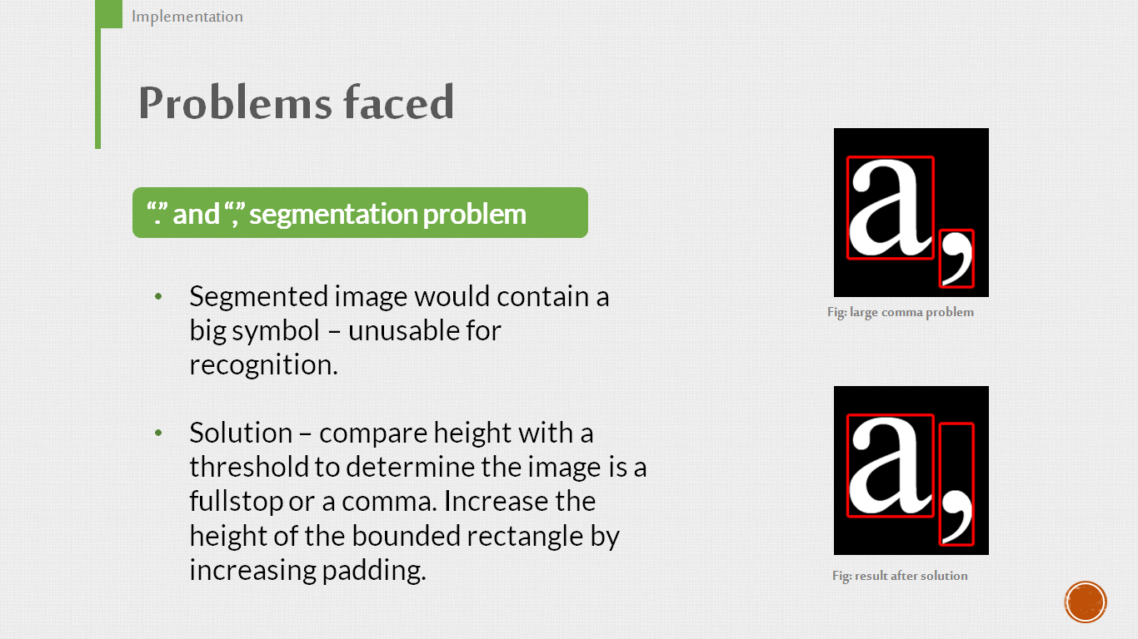
Problems Faced
“.” and “,” segmentation problem
Segmented image would contain a big symbol-unusable for recognition.
Solution – compare height with a threshold to determine the image is a full stop or comma. Increase the height of bounded rectangle by increasing padding.
Fig: Two separate contours in “i”
Fig: result after solution

Slide 18
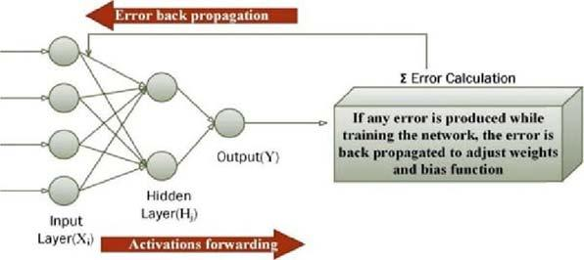
Recognition using Trained ANN
Artificial Neural Networks are the biologically inspired simulations performed on the computer to perform certain specific tasks like clustering, classification, pattern recognition etc.
Artificial Neural Networks, in general — is a biologically inspired network of artificial neurons configured to perform specific tasks.

Slide 19
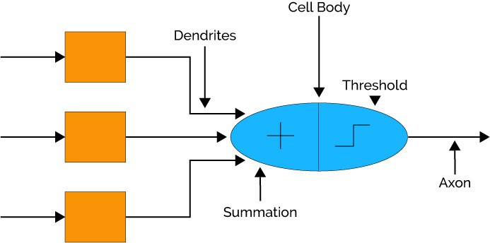
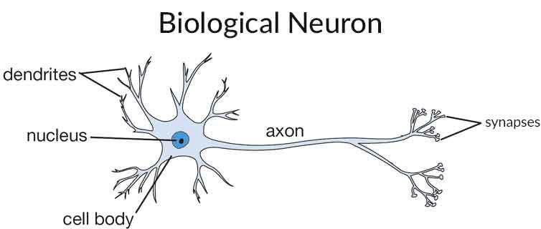
Similarity of ANN with Biological Neural Network

Slide 20
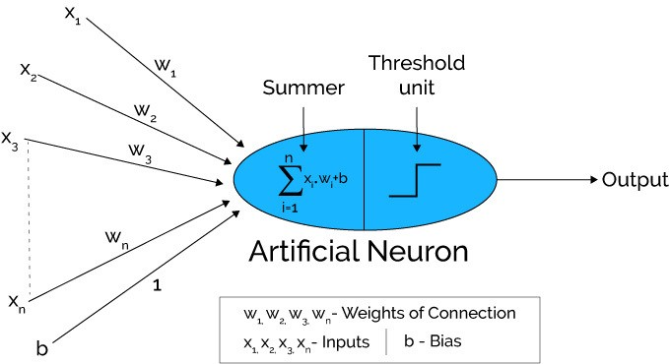
How Does Artificial Neural Network Works?

Slide 21
Create training dataset
Neural Network Design
Character set:
• 0 –9 : 0 –9
• a –z : 10 –35
• A –Z : 36 –61
• . , - ? : 62,63,64,65
• 400 sample images for each character (32 x 32)
Three layers:
• Input layer –1024 neurons
• Output layer –66 neurons

Slide 22
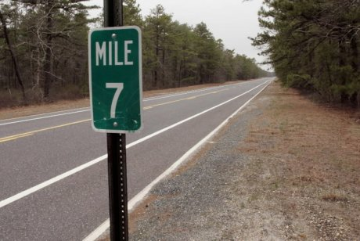

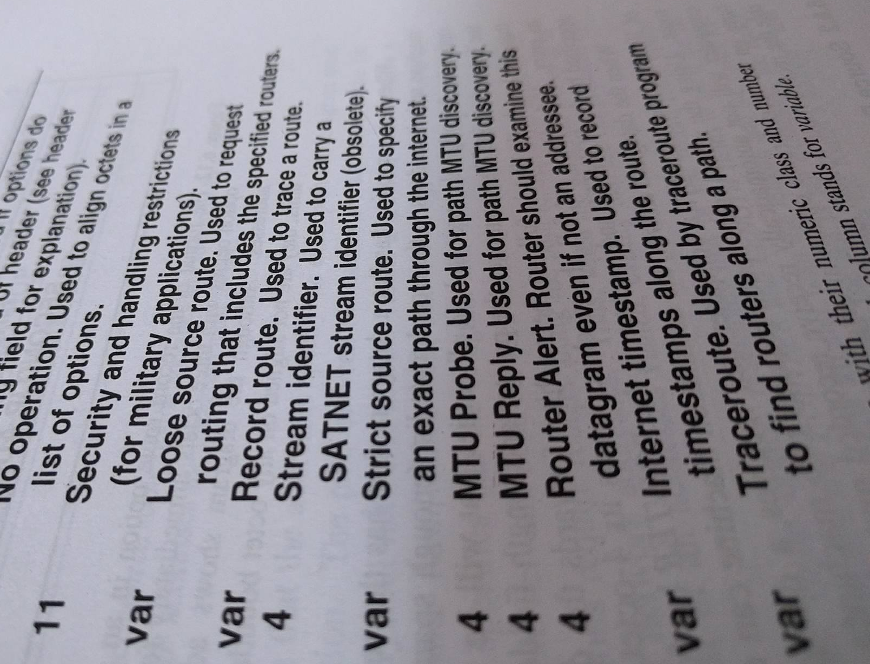
Limitations
Cannot work with an input image consisting of only a small amount of text and a large amount of scenery.
The text should be darker and the background should be brighter.
The text lines in the input image should be prominently separated such that it is possible for detection by horizontal projection method.

Slide 23

Future Work
Making the program user friendly by adding User Interface
For conflicts between similar looking characters, introducing optimisation by comparing words with English dictionary
Handwritten Recognition

Slide 24
References
[1]"Let’s Take Things Step by Step, Shall We? | How OCR Works", How OCR Works | A Close Look at Optical Character Recognition, 2017. [Online]. Available: http://www.how-ocrworks.com/OCR/OCR.html. [Accessed: 08- Nov- 2017].
[2]"Optical character recognition", En.wikipedia.org, 2017. [Online]. Available: https://en.wikipedia.org/wiki/Optical_character_recognition#Pre-processing. [Accessed: 08- Nov- 2017].
[3]H. OnDemand, "OCR Document", Haven OnDemand, 2017. [Online]. Available: https://dev.havenondemand.com/apis/ocrdocument#overview. [Accessed: 08- Nov- 2017].
[4]"Artificial Intelligence Neural Networks", www.tutorialspoint.com, 2017. [Online]. Available: https://www.tutorialspoint.com/artificial_intelligence/artificial_intelligence_neural_networks.ht m. [Accessed: 08- Nov- 2017].
[5]"Artificial neural network", En.wikipedia.org, 2017. [Online]. Available: https://en.wikipedia.org/wiki/Artificial_neural_network. [Accessed: 08- Nov- 2017].

